Slide 1
Product Data Analysis
Introduction:
It is important as a Data Analyst to first understand the data on which analysis is carried on and ensure the data is tidy in order to obtain and make the right analysis.
In this project a few basic sanity checks is applied to ensure the data is tidy and used a basic visualisation techniques to understand the trends and behaviour of the data series.
This is an exploratory analysis of a Product data set which records the time and different products sold at a location, the attributes are as follows:
Date_w – Date at which the product was sold.
Price – Price of the product sold.
Total_vol – Volume of the products sold.
Bags_s, Bags_t, Bags_l, Bags_lx – Measurements of the bag.
Plu_1, Plu_2, Plu_3 - Look-up codes (numbers that uniquely identify a produce).
Type – Type of the product.
Year – The year in which the product was sold.
Location – The location of the product sold.
Tarun.s.sarode

Slide 2
Methodology:
To analyse the ‘Product_a’ data set, the statistical tool Python(Jupiter) is used.
The libraries such as pandas, numpy, seaborn, geopandas, geopy, plotly, googlegeocoder, folium etc, were used in the analysis.
The statistical methods such as Mean, Median, SD, Variance etc, are used to understand and infer information about the data set.
The visualisations such as Time series, Heatmap, bar graph etc, are used for analysis.
Tarun.s.sarode

Slide 3
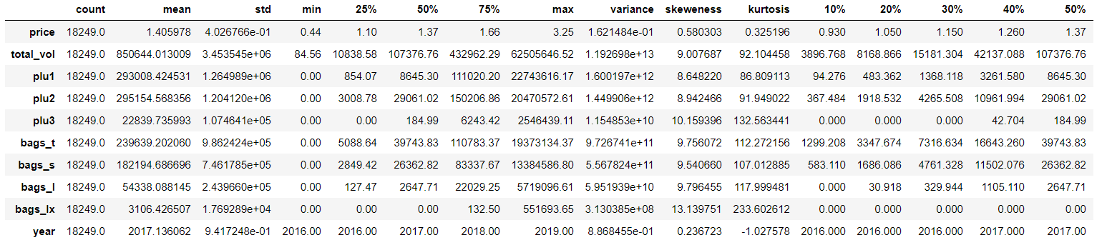
Analysis:
From the statistical output it can be observed that the dataset has 18249 entries.
Total volume has the highest values from all the other and is less significant here. The highest mean is for ‘Plu2’ followed by ‘Plu1’. The SD is highest for ‘Bags_t’ and the lowest for ‘Plu3’. The Maximum values are form ‘Plu1’, ‘Plu2’ and ‘Bags_t’. The highest variance is between ‘Bags_t’ and implies the data are widely spread. The skewness is highest for ‘Bags_lx’ which implies the values are just similar which is also evident from kurtosis and the lowest for ‘Plu1’.
Tarun.s.sarode

Slide 4
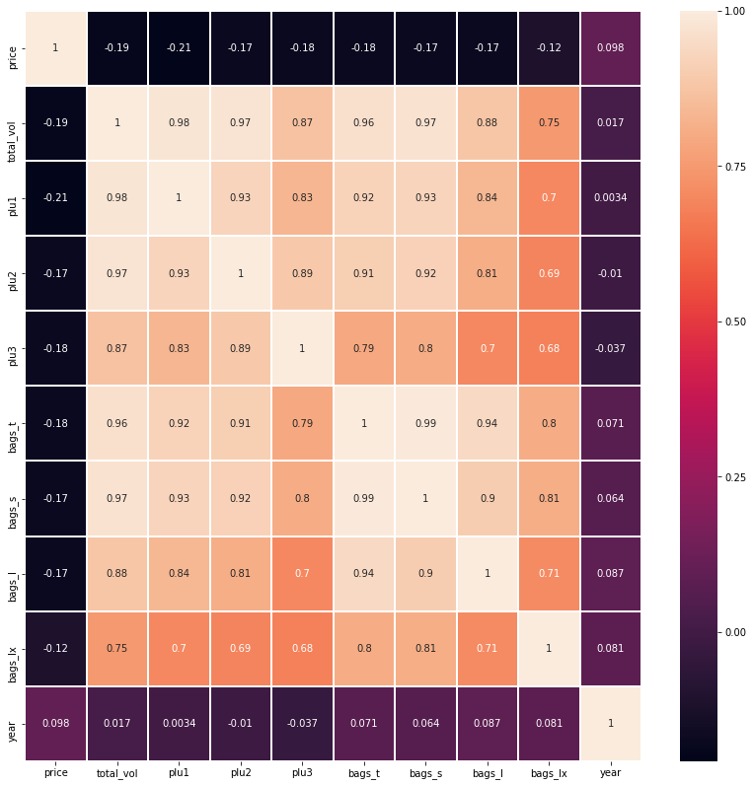
Correlation Matrix.
From the heatmap calculated using Pearson method
The positive correlation is highest between
1st - Bags_t and Bags_s.
2nd - Total volume and Plu1.
3rd – Total volume and bags_s.
There is no positive relation between price or any other variable.
Tarun.s.sarode

Slide 5
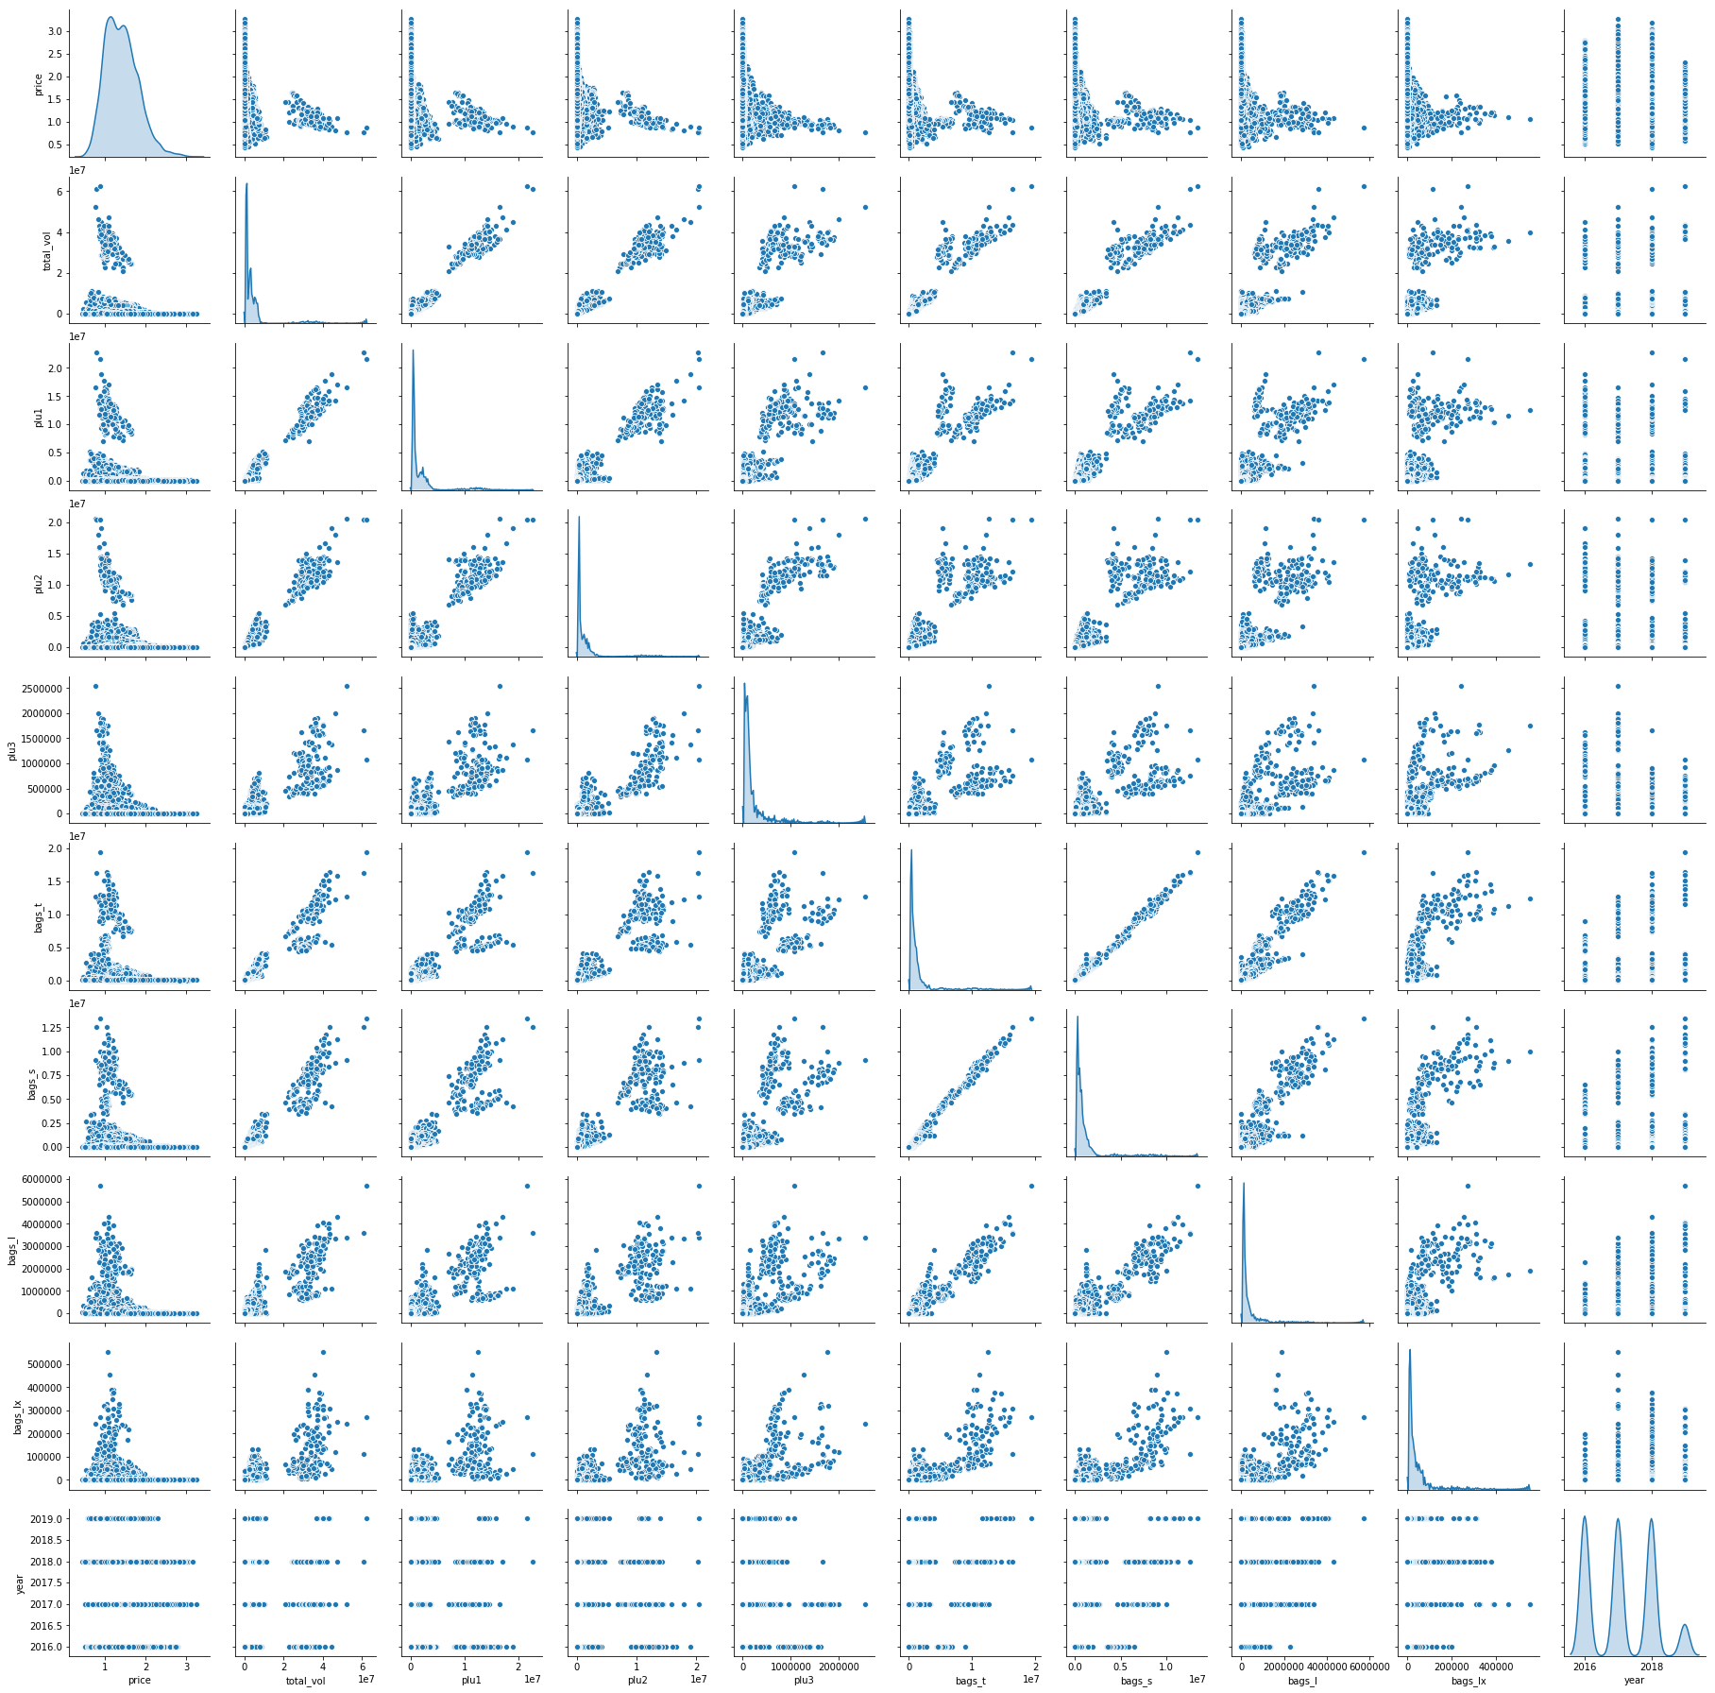
Pair plot
It is a visualization of the correlation matrix.
From the pair plot it can be confirmed that there is a highly positive relation between ‘Bags_t’ and ‘Bags_s’ followed by ‘Plu1’ and ‘Totol volume’.
The histogram shows that all the variables are right skewed except price and year.
Tarun.s.sarode

Slide 6
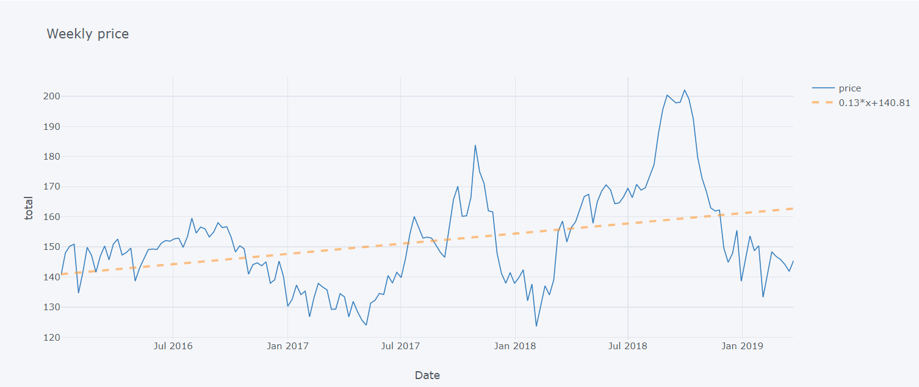
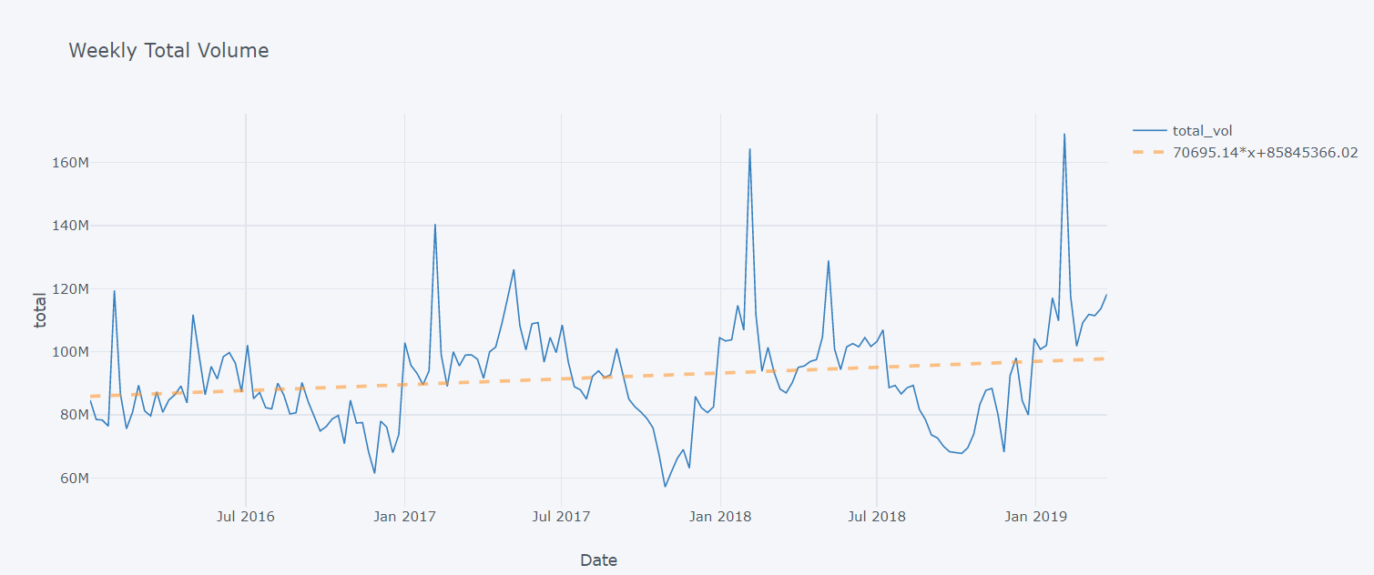
Price
From the timeseries plot of Price it can be seen that there is always a rise of prices between the months of August and October and low between February and April. It has a positive increase.
Total Volume
It can be observed that there is a high and sudden increase during February and the lowest has been in the October and November. It also shows very slight increase through the years.
Tarun.s.sarode

Slide 7
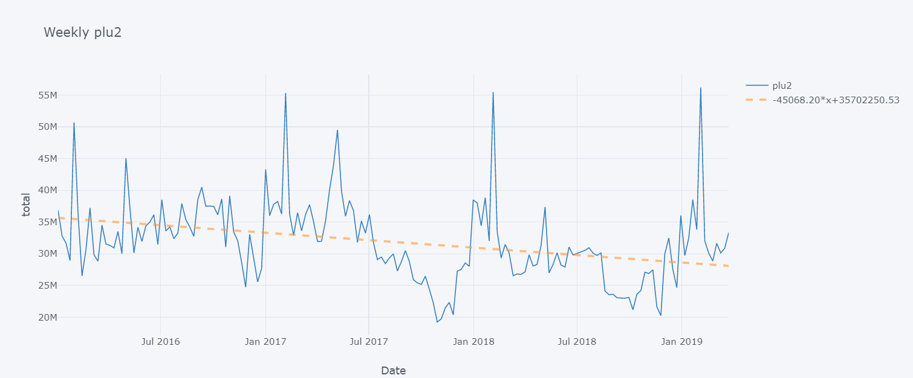
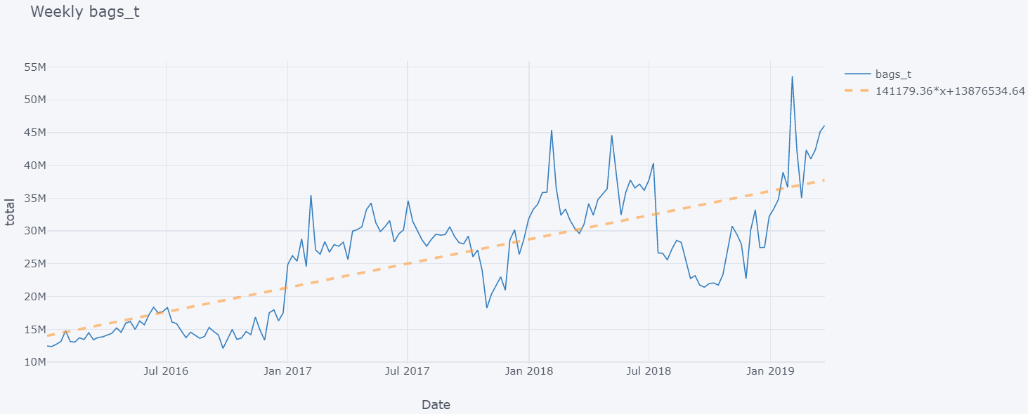
Plu2
From the time series it can be seen that the there is sudden increase in February and lowest during October and November and has the same behaviour of Total volume but it has been slightly decreasing trend.
Bags_t
From the plot it can be seen that there is a increasing trend with the highest being in February and lowest in October and November.
Tarun.s.sarode

Slide 8
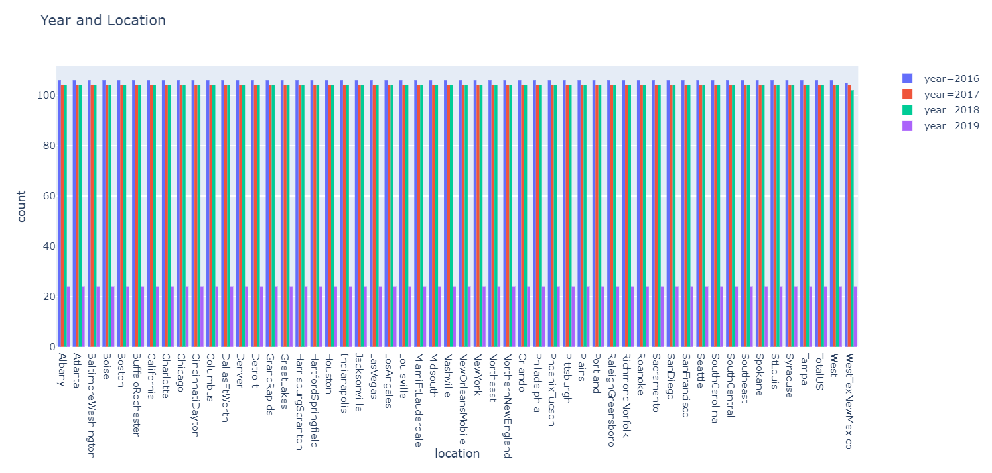
Bar chart
From the chart it can be seen that the transactions carried on during the four years are the same in all the locations and only WestTexNewMexico has reduced in the year 2018.
Tarun.s.sarode

Slide 9
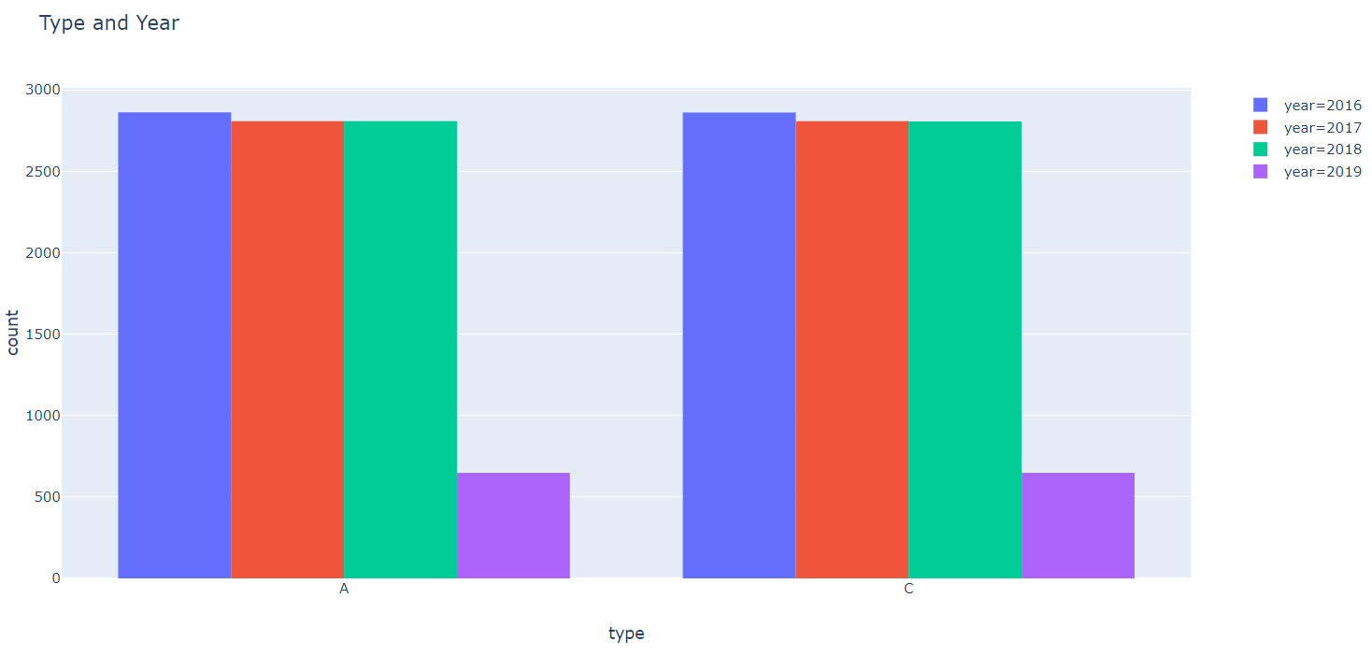
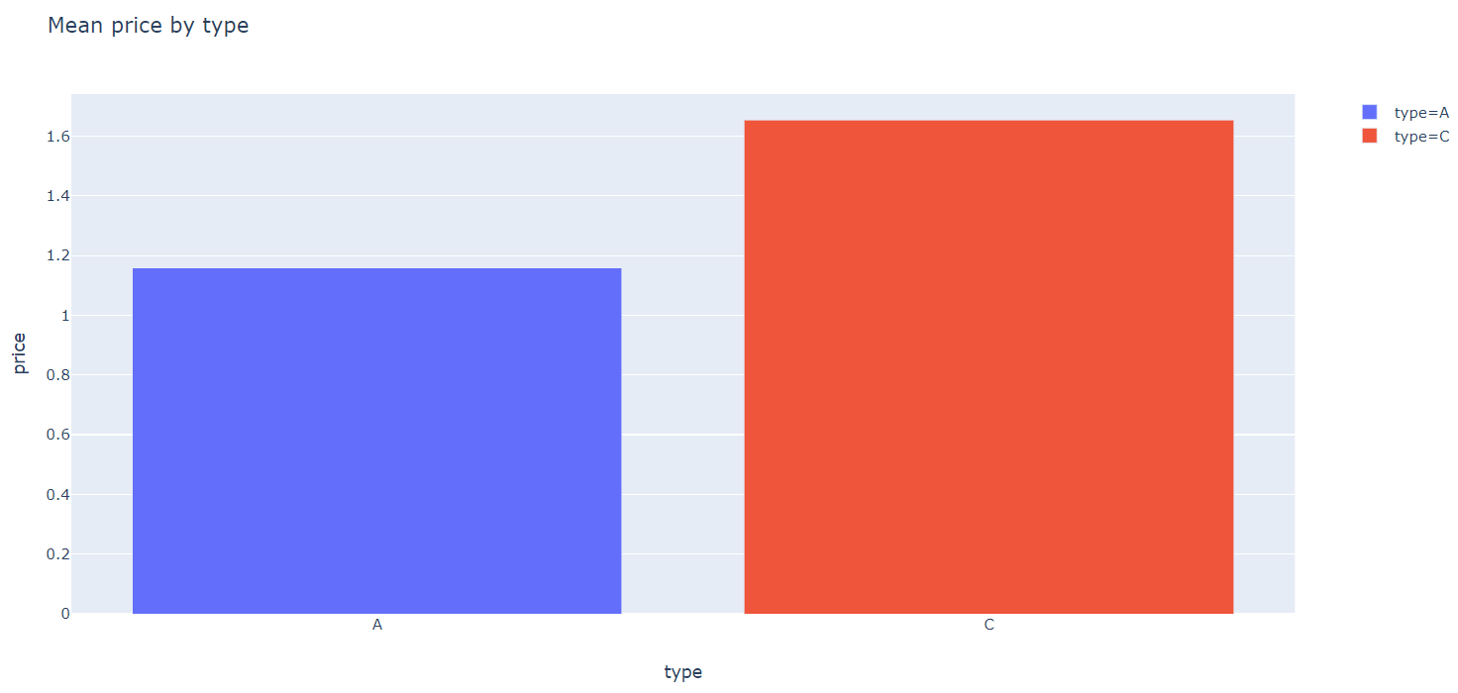
Bar chart of Type and Year
There has been no change in the two types of bags sold and are same through the four years.
Bar chart of Type and Mean Price
It can be clearly seen that the ‘Type C’ has a higher price than the ‘Type A’.
Tarun.s.sarode

Slide 10
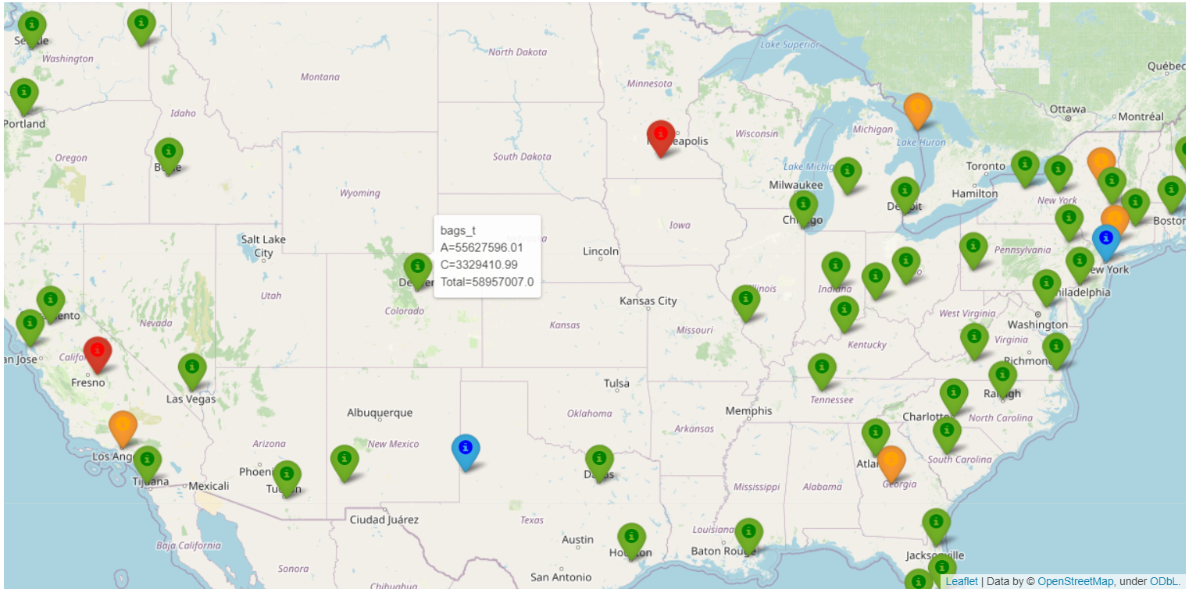
Map
The map with the markers is a representation of the locations.
The different colour represents the different price of the ‘Bags_t’ and types which are:
Green = 0 – 200000
Blue = 200001 – 400000
Orange = 400001 – 600000
Red = 600001 – 800000
Black = Otherwise
It can be seen that most of the places have sales between 0-200000.
Tarun.s.sarode

Slide 11
Conclusion:
From the Analysis it can be concluded that the ‘Bags_t’ was the highest sold product.
There is high sales during the months February, March and April and low during the months October and November.
The ‘Type C’ has high price than the ‘Type A’ .
The sales in all the locations are same throughout the years when totalled and only WestTexNewMexico is reduced the sale in 2018 but same as others in 2019.
Further Analysis:
The relation between the ‘Bags_s’ and ‘Bags_t’ can be further analysed, followed by the analysis of the decreasing trend of ‘Plu2’ even though all the other variables are showing an upward trend.
Tarun.s.sarode

Slide 12
Thank You
Tarun.S.Sarode

